Slide 1

WEALTH MANAGEMENT BY AND FOR PRACTITIONERS
“Never settle for anything less than what you deserve. It’s not pride, it’s self-respect.”
— Chanakya
SEBI Registered Portfolio Manager · Registration No: INP000006040 · chanakyacapital.in
01

Slide 2
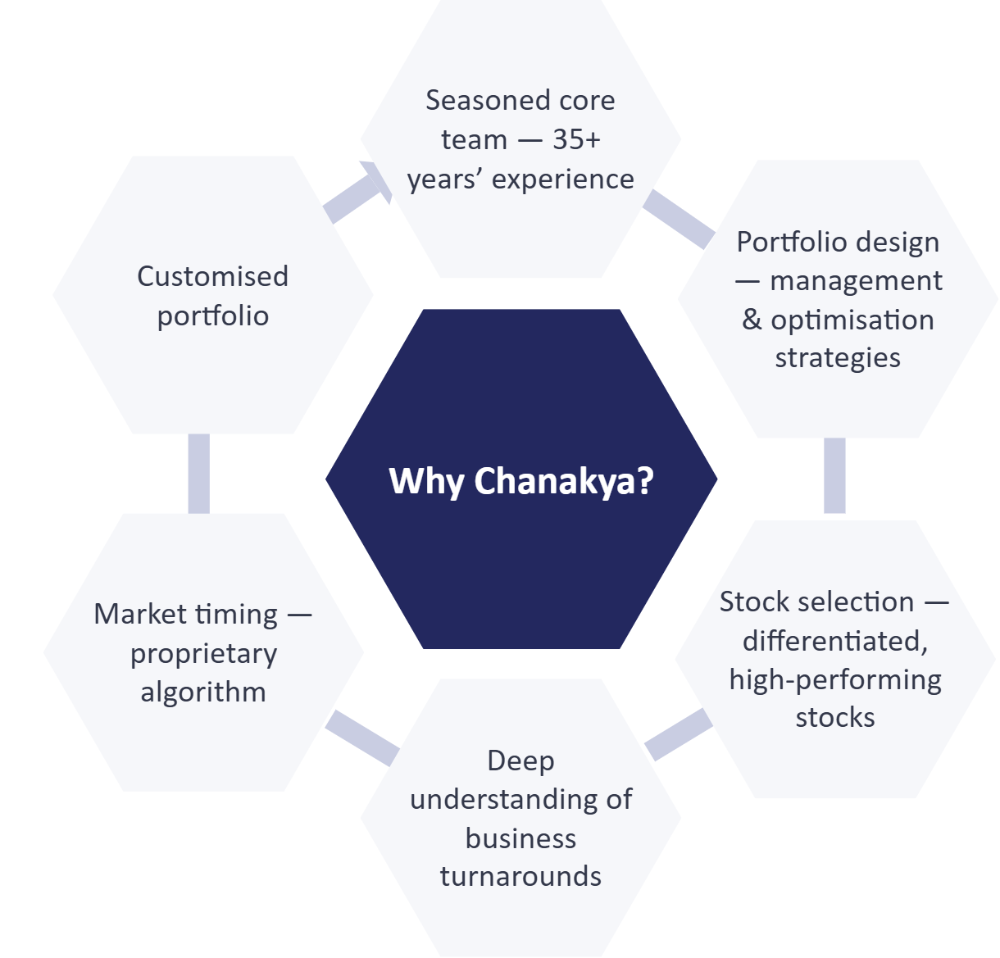
ABOUT CHANAKYA CAPITAL
Chanakya Capital is a SEBI-registered Portfolio Management Service (PMS) focused on high-conviction, research-driven equity investing.
Founded in 2018, we manage capital for High Net Worth Individuals, Family Offices, and sophisticated investors seeking long-term wealth creation through disciplined portfolio construction.
Founders have over 80 years’ experience advising institutions in India and globally
Managing investments in Chanakya since August 2018
Our commitment to excellence, integrity, and client satisfaction sets us apart
100+ years
Combined leadership experience
SEBI Registered Portfolio Manager · Registration No: INP000006040 · chanakyacapital.in
02

Slide 3
PURPOSE & INVESTMENT PHILOSOPHY
Purpose
We at Chanakya work to enable our investors to become wealthy.
Investment Philosophy
To partner with innovative companies for creating wealth for our investors.
Innovations have many forms — product innovation, organisational innovation, and more.
The most meaningful and lasting innovation centres around trust — among customers and employees — in the long-term future of the company. We at Chanakya make money for our investors by having a deep understanding of the quotient of trust and the process of innovation in our investee companies.
SEBI Registered Portfolio Manager · Registration No: INP000006040 · chanakyacapital.in
03

Slide 4
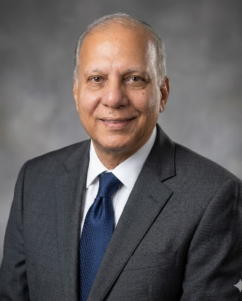

LEADERSHIP TEAM
A disciplined leadership team aligned with your long-term financial objectives.
Rajesh Tiwari
Gautami Desai
Chief Investment Officer & Principal Officer
Fund Manager & Chief Operating Officer
20+ years in equity research and portfolio management
Managed multi-billion INR equity portfolios
Extensive experience in bottom-up fundamental research
BE; MMS (Finance)
Over 30 years of experience in banking, credit, and equity investments
Former senior leadership roles at UTI / Axis Bank
Advised global institutional investors on India allocation
MBA (IIM Ahmedabad); PhD (Finance), University of North Texas.
SEBI Registered Portfolio Manager · Registration No: INP000006040 · chanakyacapital.in
04

Slide 5
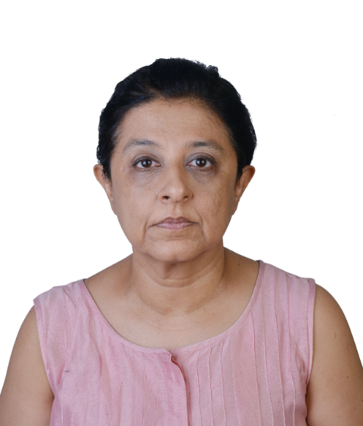
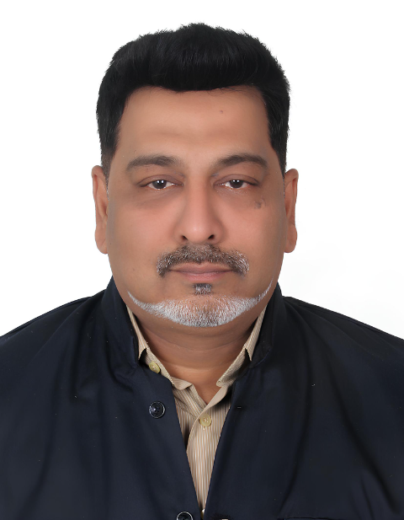


SEASONED CORE TEAM
A wealth of experience
Varsha Valecha
Venkat
Senior Vice President, Investments
Chief Business Officer (Sales) & Principal Officer (GIFT Branch)
Over 30 years’ experience in investment banking and Indian equities; managed fundraising mandates and M&A for organisations such as Infosys, Hindalco, and HCL Technologies
Previously associated with Enam, Royal Bank of Scotland, and Edelweiss
B.Com; Masters in Management Studies (Mumbai University)
25+ years’ experience in institutional fundraising and alternatives across PMS, AIF, private equity, and portfolio advisory; raised ₹500+ crore from family offices, corporates, NBFCs, and institutional pools
Previously associated with TIW Capital Group, ICICI Securities, and L&T Mutual Fund; deep relationships with UHNIs, family offices, and institutional allocators
MBA (ICFAI Business School); Strategic Management (IIM Kashipur)
Vivek Jain
Avish Bhansali
Equity Research Analyst & Compliance Officer
Equity Research Analyst & Compliance Officer (GIFT Branch)
7 years of experience in equity research, business finance, audit & taxation; previously associated with Bharat Petroleum and Chaturvedi & Shah
Expertise in valuation, financial due diligence, company law, taxation, and accounting & auditing standards
Chartered Accountant (ICAI); B.Com (MDSU University)
5 years’ experience in equity research, auditing, taxation, business finance and management
Focuses on auto ancillaries, capital goods, power, and bearing industries
Chartered Accountant (ICAI); B.Com (Gujarat University)
SEBI Registered Portfolio Manager · Registration No: INP000006040 · chanakyacapital.in
05

Slide 6
UNDERSTANDING ORGANISATIONAL & BUSINESS TRANSFORMATIONS
Ability to identify turnarounds and companies shifting orbits
Understand innovation of products and services through ground research combined with business analysis
Rigorous research process where every company must be observed closely for at least 2 years before investing
We create a very concentrated portfolio, with the top 15 companies comprising 80% of the portfolio, as we invest only after complete clarity and based on assumptions we feel convinced about
SEBI Registered Portfolio Manager · Registration No: INP000006040 · chanakyacapital.in
06

Slide 7
STOCK SELECTION — INVESTMENT PROCESS
We are students of the mind of the management. Our focus is on the cash flow of companies — weaving qualitative aspects of business into discounted cash flow valuation.
Our approach
Where our returns come from
We do not invest in a company if there is insufficient margin of safety, no matter how ‘great’ it may seem on the outside
We offer our investors a balanced mix of good businesses with quality management and turnaround companies available at great value
Skin in the game — a high percentage of the Chanakya fund managers’ net worth is invested alongside our investors
Easy liquidity — no exit load
Depth of research and thorough methodology of arriving at our investment decisions
Hard research-based conviction when the market is yet to discover the true potential of a stock
Our strong focus on ground research ensures we get a 360-degree view of the company and thereby minimise judgment errors
SEBI Registered Portfolio Manager · Registration No: INP000006040 · chanakyacapital.in
07

Slide 8
PORTFOLIO DESIGN: FIRST PRINCIPLES
We value a stock based on the first principles of:
Quality of ownership and management
Value system and vision
Business model and long-term competitiveness
We never invest in a company which short-changes minority investors or makes other financial or governance transgressions
DCF valuation based on an estimate of future cash flows over a very long term
We use maths to analyse past investment data to evaluate and continuously refine investment parameters
SEBI Registered Portfolio Manager · Registration No: INP000006040 · chanakyacapital.in
08

Slide 9
MARKET TIMING — PROPRIETARY ALGORITHM
Our empirical algorithm helps mitigate the challenges of market timing by:
Timing the market with our proprietary order management
Enhancing our ability to capitalise on market volatility
Ensuring better pricing by investing gradually
Standing the test of time in choppy market conditions
SEBI Registered Portfolio Manager · Registration No: INP000006040 · chanakyacapital.in
09

Slide 10
PERFORMANCE
Portfolio performance* as on October 13, 2026
Period
Portfolio (%)
Nifty 50 TRI (%)
3 Months
-1.85
-5.91
6 Months
5.22
-3.92
1 Year
8.09
-8.95
2 Years
6.31
-3.48
3 Years
14.70
6.02
4 Years
18.00
8.73
5 Years
15.10
5.83
7 Years
18.95
11.78
Since Inception (13.08.2018)
15.08
10.06
Consistent track record of outperformance across market cycles
(Source: PMS Bazaar)
*Net of all expenses and fees · *Returns above 1 year are annualised (TWRR) · *Past performance is not indicative of future results · Source: HDFC FA
SEBI Registered Portfolio Manager · Registration No: INP000006040 · chanakyacapital.in
10

Slide 11
PORTFOLIO DATA & IMPORTANT RATIOS
Portfolio composition
Financial metrics
Important ratios
Category
Sep 30, 2026 (%)
Financial Metric
Aug 31, 2026
Ratios (3Y)
Aug 31, 2026
Large Cap
47.00
Standard Deviation
17.60
Average Market Cap (in ₹ lakh crore)
2.35
Holding Companies*
17.15
Jensen’s Alpha (%)
8.33
Average P/E
18.98
Mid Cap
5.64
Beta
1.08
Weighted average margin of safety — Chanakya’s estimate (%)
300
Small Cap
30.17
Sharpe Ratio
0.74
Cash
0.04
Conservative risk parameters overall.
Correlation
0.81
*Underlying assets are shares of holding companies — available at a 50–80% discount to NAV
In light of return measures like absolute return or risk-adjusted “active return”, our numbers place us in the top league of AMCs in India. (Source: PMS Bazaar)
Statutory disclaimer: performance figures are not verified by SEBI.
SEBI Registered Portfolio Manager · Registration No: INP000006040 · chanakyacapital.in
11

Slide 12
IS IT A GOOD TIME TO INVEST IN INDIAN OR GLOBAL STOCKS?
Why India, why now
The right price is the right time
Improving robustness of institutional mechanisms due to continuing economic and regulatory reforms in India
Increasing sophistication in demand for various goods and services
Emergence of a new set of enlightened entrepreneurs and managers
Increasing global competition improving quality of products and services
Long-term vision of key Indian decision-makers
Our margin of safety criteria ensures investment only when future prospects and the likely return on a stock are attractive
Our in-house algorithm, based on our past investment data, ensures gradual investment in a stock at appropriate price levels
For us, a disciplined, research-based investment process ensures investment in our stocks always at the right price — and thereby the right time
ना भूतो न भविष्यति — we believe the best time ever for the Indian economy and its set of innovative firms has come now. The scale of wealth creation in the coming decades in India is likely to be far more than whatever one has seen so far.
SEBI Registered Portfolio Manager · Registration No: INP000006040 · chanakyacapital.in
12

Slide 13
CHANAKYA GIFT CITY GROWTH FUND — PROPOSED PORTFOLIO STRATEGY
Allocation
Structure & selection
Maximum allocation to unlisted Indian equities: 15%
Maximum allocation to global equities: 15%
At least 85% of the portfolio will be invested in listed Indian equities
The open-end fund structure necessitates investment in low-impact-cost stocks; this is to be achieved by means of appropriate portfolio structure and selection of stocks
Selective investment in high-quality global stocks in knowledge and service businesses at an adequate margin of safety — to avail of value creation in the cutting-edge businesses of the future
Selective investment in Indian stocks very close to IPO
Superior risk management
Portfolio weight of a stock is a function of
Quality of management
Margin of safety, viz. long-term return estimated by us
Risk limits based on the above two factors
Ensures a superior risk management outcome
No margin call risk
No illiquidity risk
Strong legal recourse
No exit fee
Zero external leverage — investors will never get a margin call
Anytime withdrawability of principal and profits; highly liquid investments
The fund is based in strong jurisdictions, giving powerful legal recourse
Easy liquidity — no exit load on withdrawals
SEBI Registered Portfolio Manager · Registration No: INP000006040 · chanakyacapital.in
13

Slide 14
OVERVIEW OF GIFT CITY, INDIA
Gujarat International Finance Tec-City (GIFT) is India’s first and only International Financial Services Centre (IFSC).
India’s only approved IFSC
GIFT is positioned as India’s gateway to global financial markets, facilitating inbound and outbound investments and hosting a myriad of other financial activities.
Globally benchmarked IFSC developed by the Government of Gujarat through a joint venture
Fully integrated with top-tier infrastructure, connectivity, technology, and legal frameworks
The International Financial Services Centres Authority (IFSCA) is a unified regulator for the IFSC. The regulatory powers of four financial services regulators in India — RBI, SEBI, IRDAI and PFRDA — have been vested in IFSCA.
Stock exchanges in GIFT City have achieved single-day highest volumes of USD 24 billion
Ranked 1st as a rising financial hub in the Global Financial Centres Index
SEBI Registered Portfolio Manager · Registration No: INP000006040 · chanakyacapital.in
14

Slide 15
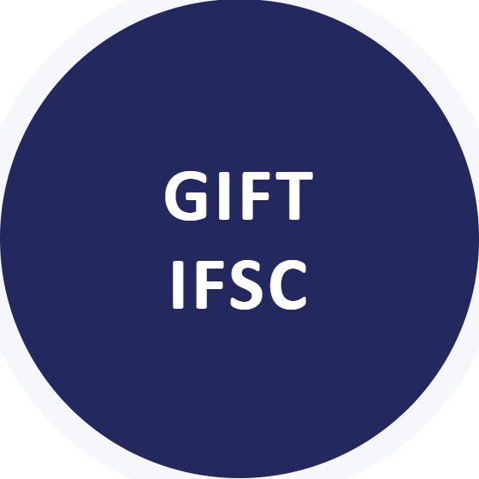
WHY INVEST THROUGH GIFT?
Best-in-class regulations (internationally aligned)
Availability of skilled talent pool
Dedicated & unified financial regulator
Sovereign support, including special carve-outs from domestic laws
Permitted to borrow funds and engage in leveraging activities
Beneficial cost of operations
No limits on outbound investments
Competitive tax regime
GIFT IFSC is the best way to invest in India
Stable regulatory regime at par with global jurisdictions · Favourable carve-out in tax laws to promote GIFT IFSC-based funds
SEBI Registered Portfolio Manager · Registration No: INP000006040 · chanakyacapital.in
15

Slide 16
WHO CAN INVEST?
Targeted investors shall include, but not be limited to, sophisticated and/or private investors including non-resident Indians, family offices, government institutions, corporates, public sector undertakings, private banks, insurance companies, global development financial institutions, multilateral organizations, and institutional investors, and other permissible investors under applicable laws, including accredited investors.
Who can invest
Who cannot invest
NRIs
Foreign investors
Individuals
Non-individuals
Indian residents
NRIs and overseas investors residing in nations on the FATF blacklist
NRIs and overseas investors residing in grey-list countries will require enhanced diligence
NRIs and overseas investors from China, Hong Kong, and Qatar
The above-mentioned investors should be from FATF-compliant jurisdictions.
The Fund is not available for subscription by resident Indian(s). For investors based in the UAE, only reverse solicitation is permitted.
Where any investor at the time of onboarding is a non-resident and later has a change in status to ‘Resident Indian’, such change shall be immediately notified to the FME. The FME shall, per its discretion and evaluation, take necessary steps which may include compulsory redemption for such investor, restriction on further subscription, etc.
SEBI Registered Portfolio Manager · Registration No: INP000006040 · chanakyacapital.in
16

Slide 17
COMPARATIVE TAX FRAMEWORK — NRI DIRECT INVESTMENT vs IFSC AIF
Income Stream
NRI investing from Singapore into India#
IFSC Cat III AIF (Trust)
Capital gains on listed equity
Exempt (under India–Singapore treaty)
Short term — 20%; long term — 12.5%. Applicable at fund level; exemption for investors
Units of equity-oriented AIF
—
Exempt (under domestic law)
Taxation in hands of investors
Taxable in hands of investors
Investors are exempt from tax
PAN and tax return filing compliance
Applicable
—
GST on management fee / performance fee
Yes
No GST
#Subject to treaty eligibility by providing Form 10F and tax residency certificate · Plus applicable surcharge and cess
SEBI Registered Portfolio Manager · Registration No: INP000006040 · chanakyacapital.in
17

Slide 18
PRINCIPAL TERMS OF INVESTMENT
Type of Scheme
Open-ended, Category III, Alternative Investment Fund
FME
Chanakya Capital Services Private Limited (IFSC Branch)
Investee Fund
Chanakya Growth Fund
Fund Structure
Standalone Fund
Benchmark
NIFTY 50 TRI
Fund Managers (Investee Fund)
Rajesh Kumar Tiwari & Gautami Rahul Desai
Minimum Commitment Amount
USD 150,000
Lock-in
NA
SEBI Registered Portfolio Manager · Registration No: INP000006040 · chanakyacapital.in
18

Slide 19
PRINCIPAL TERMS OF THE FUND
Class
Class A
Minimum Capital Commitment
USD 150,000 and above
Management Fee p.a.
2%
Performance Fee
20% performance fee (subject to an 8% hurdle rate)
Exit Load
NA
For comprehensive details on various classes, fee structure, and expenses, please refer to the Private Placement Memorandum and Contribution Agreement.
SEBI Registered Portfolio Manager · Registration No: INP000006040 · chanakyacapital.in
19

Slide 20
DISCLAIMER
This presentation is being provided by Chanakya Capital for informational purposes only and is intended solely for the use of the recipient. It does not constitute an offer to sell or a solicitation of an offer to buy any securities or investment products.
Chanakya Capital is a SEBI-registered Portfolio Manager. Investments in securities are subject to market risks, including the possible loss of principal. There can be no assurance that the investment objectives of any strategy will be achieved.
Past performance is not indicative of future results. Any returns, projections, or forward-looking statements are based on assumptions and current market conditions and are subject to change without notice.
The information contained herein has been prepared in good faith and is believed to be reliable; however, no representation or warranty, express or implied, is made as to its accuracy, completeness, or adequacy. Chanakya Capital shall not be liable for any direct or indirect loss arising from the use of this material.
Recipients should conduct their own due diligence and consult their financial, legal, and tax advisors before making any investment decision.
This document is confidential and may not be reproduced, distributed, or transmitted, in whole or in part, without the prior written consent of Chanakya Capital.
SEBI Registered Portfolio Manager · Registration No: INP000006040 · chanakyacapital.in
20

Slide 21
THANK YOU
Reach out to us:
Address
F-115, Nahar & Seth Industrial Estate, Next to P&G Plaza, B. D. Chakala Road, Andheri (E), Mumbai – 400 099
Phone
+91 99305 50052
Email
rajesh.tiwari@chanakyacapital.in · gautami.desai@chanakyacapital.in
Web
www.chanakyacapital.in
SEBI Registered Portfolio Manager · Registration No: INP000006040 · chanakyacapital.in
21

